Slide 1
Palmoria Group HR Analysis
A Power BI-driven insight report addressing gender inequality, salary structure, and performance ratings across Palmoria’s workforce.

Slide 2
Project Background
This a project assigned to me by DSA at the completion of their three months data-analysis training which was so impactful. Palmoria Group data set was giving to me to analyze and rectify structural imbalance in gender pay and performance in different sectors.

Slide 3

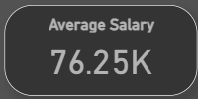

Slide 4

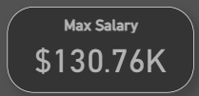

Slide 5
Bonus Allocation Analysis
Based on performance ratings, bonuses were computed. Highest payouts are in North west region “Kaduna -$137.89M, followed by North central “Abuja- $124.72M, while south west "Lagos-$98.05M” has the lowest pay.
Total company-wide bonus obligation: $3.2M.

Slide 6
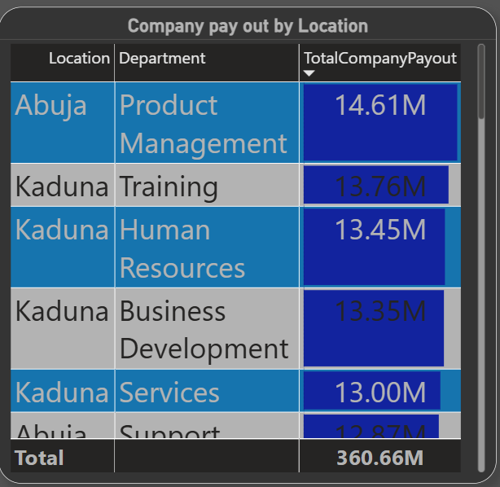

Slide 7
Gender Distribution
Breakdown of employee gender by department and region reveals imbalance. North region is 72% male,
From the analysis in North region male tend to do better in Training, legal, product management, accounting and support while female tend to perform better in Business development, Human Resources, Product management and support.

Slide 8
In South region, male tend to perform better in Engineering, Business development , services and Training while female performed better in Business development, Marketing and Research development.

Slide 9
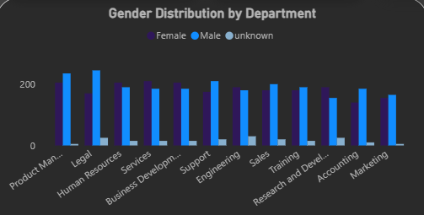

Slide 10
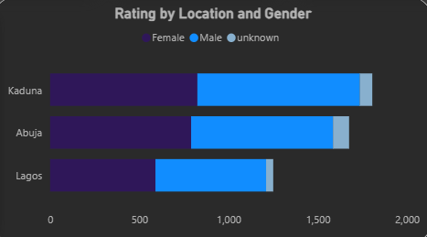

Slide 11
Performance Ratings by Gender
Male employees received higher performance ratings on average. Bias in review mechanisms is suspected and should be reviewed.

Slide 12
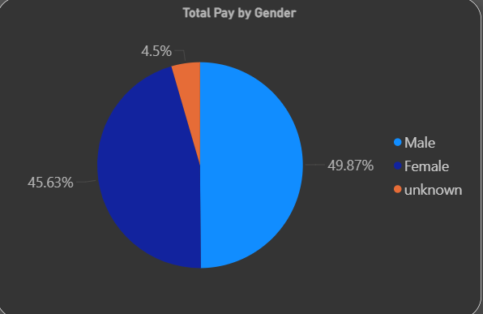

Slide 13
Gender Pay Gap Analysis
There is a clear pay gap with male employees earning. The male company pay out is 49:87% while the female is 45.63%

Slide 14
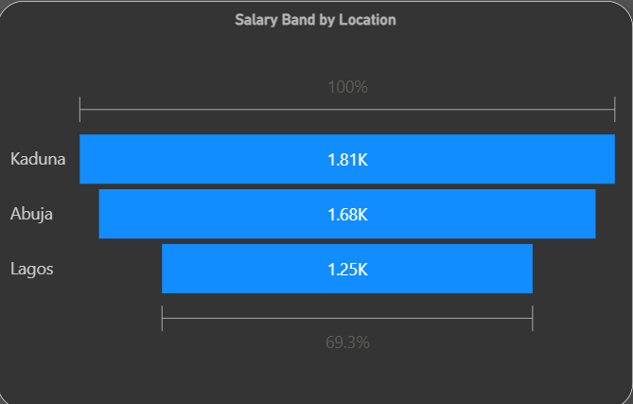

Slide 15
$90,000 Salary Compliance
38% of employees earn below the $90,000 benchmark. South and West regions require attention. Most underpayment occurs in Support and Admin.

Slide 16
Recommendations
Conduct salary audits and enforce pay equity across regions and departments.
Promote transparent and unbiased performance review systems.
Increase salaries to meet $90K minimum in low-paying departments.
Support gender equity in leadership and engineering roles.
Implement a transparent bonus structure tied to performance metrics.

Slide 17
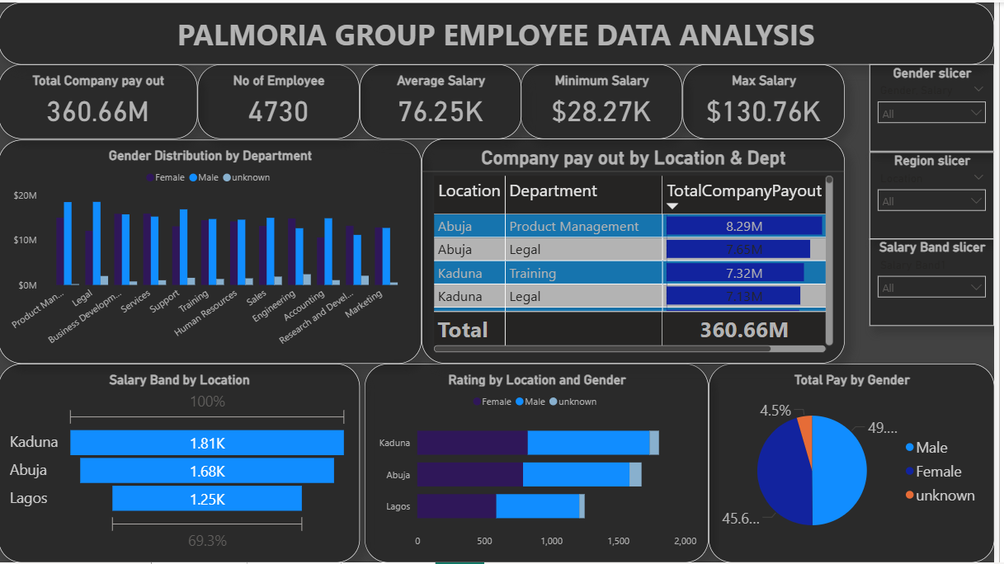

Slide 18
THANK YOU

